Slide 1
Custom Forms
For vendor records

Slide 2
Vendor packet
What questions do you ask that Skyward cannot record?
Worker’s compensation insurance
Fingerprint date/expiration
Sunbiz listing information
How do you record those questions currently?
How do you track expiring vendors?

Slide 3
Vendor profile
Why can’t I see this information in my vendor profile?
Why can’t I run a report on this information?
Custom reports let’s you run reports!

Slide 4
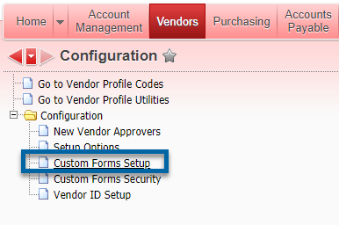
Custom forms setup
Skyward path: FINANCIAL MANAGEMENT\VENDORS\SETUP\CONFIGURATION
Custom Forms Setup
Create new/edit existing custom forms
Custom Forms Security
Assign form access to groups of users as needed

Slide 5
Add custom form
Click Add
Input name and select form type
Single Form – Information does not change each year
Multiple forms – Track changes in previously entered information
Click Save and Go to Next Step
Clicking “Save” will exit the setup wizard and allow the user to manually work on form

Slide 6
Add Custom Fields
Allows the user to create unique fields that are not
Click Expand All
Click Add Field
Input field information:
Label – field name
Data type:
Character
Date
Decimal
Integer
Logical
Lookup
Read Only Text
Tool Tip – helpful explanation of the field
Initial value – what the default value should be
Select Save option

Slide 7
Skyward Fields
Skyward fields provide read-only reference information in the custom form. To select from the available Skyward fields:
Click Select Fields.
Check the boxes of the required fields.
Click the Save button when finished.

Slide 8
Create forms
Skyward provides three ways to make custom forms.
Advanced Custom Forms – Looks like a word processor. Allows higher level of customization.
Custom Screens – The basic drag-and-drop form creator.
Custom HTML Forms – Requires knowledge of HTML and provide the ability to create forms using Javascript. (Not covered)

Slide 9
Custom Screens
Simple screen that allows the user to add/remove fields and to drag those fields into position.
Click Add Screen.
Add Skyward fields as needed.
Add custom created fields.
Drag fields to where needed.
Click the Save button.

Slide 10
Advanced custom forms
Provides user with a word processor form creating tool that allows for custom fields labels
Click Add Advanced Form.
Add form name.
Select from layout, tables, fields, javascript.
Layout: Portrait or Landscape
Table: Insert a table into the form
Fields: Select from Skyward or Custom Fields
Javascript: Enter Javascript code.
Type custom field labels into the form. Click Add to add fields. Drag fields to where needed. Use word processor to format text (bold, italics, font size, etc).
Click the Save & Close button.

Slide 11
Input Form Data
Go to Web Financial Management\Vendor\Vendor Profile
Look for Custom Forms at the bottom of the vendor tab list.
The highlighted information are shown from other Skyward fields.
Click the Edit button to input form data. (If you do not have the Edit button let us know and we will help with the security settings.)

Slide 12
Input Form Data
Fill out form data.
Click Save.

Slide 13
Vendor data mining
User can create vendor data mining reports to track the information collected in custom forms.
Contact NEFEC if you would like help setting up a data mining report.

Slide 14
questions
For copy of presentation and other documentation please go to URL below.
https://nefec.freshdesk.com/support/discussions/topics/16000028445

